Slide 1


WALMART
SALES ANALYSIS
Presented by: VIPUL KACHAVE

Slide 2



WALMART SALES ANALYSIS USING SQL
INTRODUCTION
I completed a project focused on Walmart sales analysis as part of an internship task for Mentorness. Utilizing SQL, I conducted an in-depth exploration of Walmart's extensive sales data, aiming to derive meaningful insights into sales trends, customer behavior, and product performance. This project allowed me to sharpen my SQL skills while gaining valuable experience in data analysis, providing a comprehensive understanding of how large-scale retail data can be leveraged for strategic decision-making. I am excited to share the findings and methodologies of this project on LinkedIn community.

Slide 3
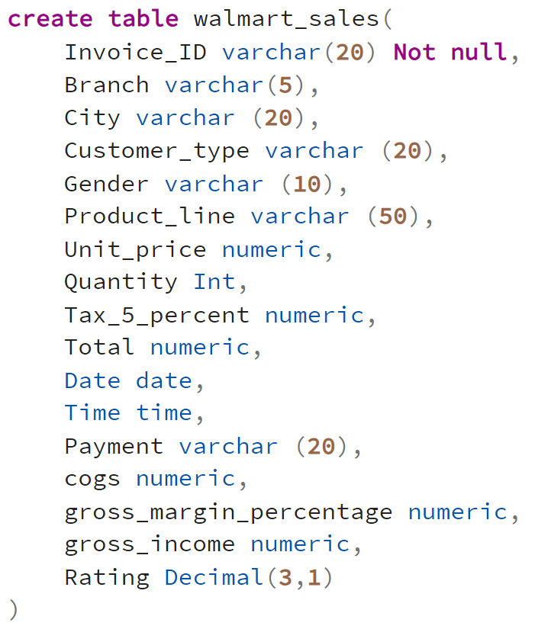
WALMART SALES ANALYSIS USING SQL
CREATING TABLE

Slide 4
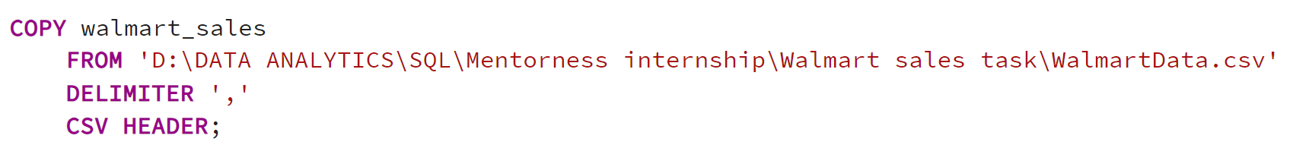
WALMART SALES ANALYSIS USING SQL
COPY DATA FROM CSV FILE INTO TABLE
SET DATE FROMAT

Slide 5

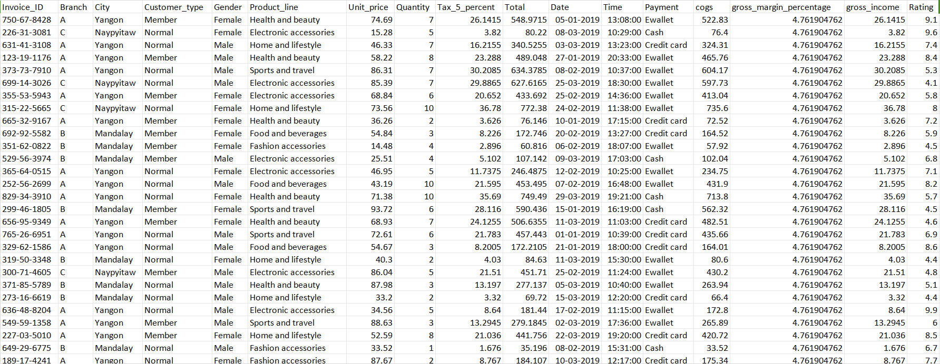

TABLE DESCRIPTION

Slide 6
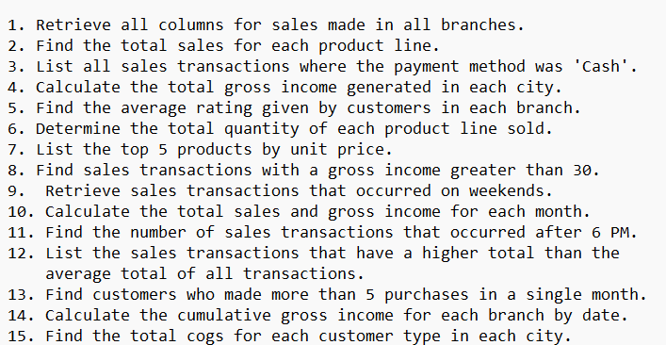
QUESTIONS

Slide 7
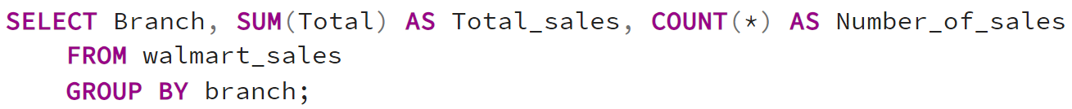
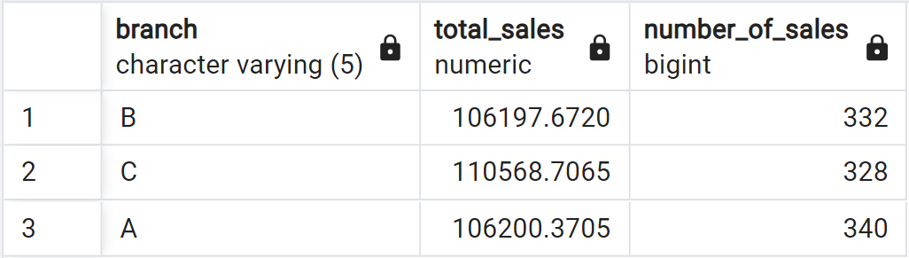
1. Retrieve Total_sales made in all Branches.
INPUT
OUTPUT

Slide 8
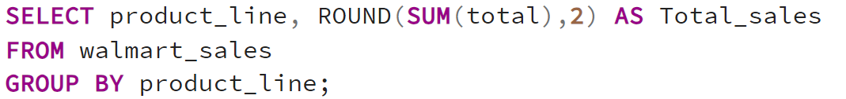
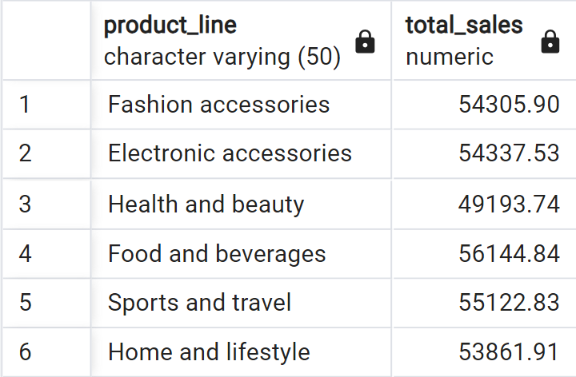
2. Find the total sales for each product line.
INPUT
OUTPUT

Slide 9
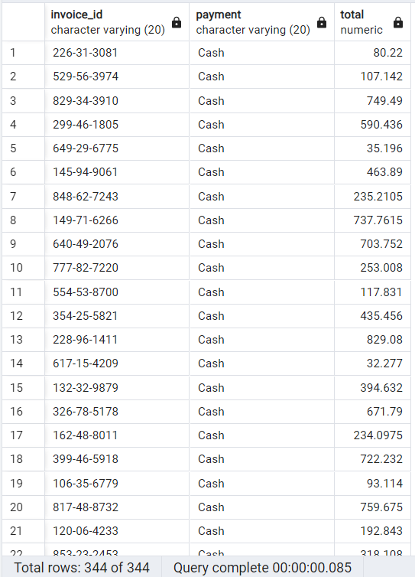
3. List all sales transactions where the payment method was 'Cash'.
INPUT
OUTPUT

Slide 10
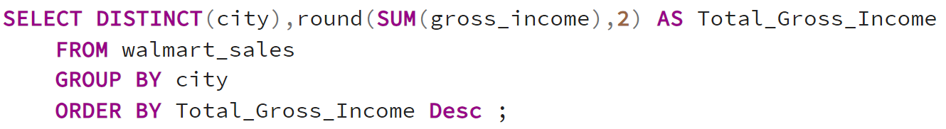
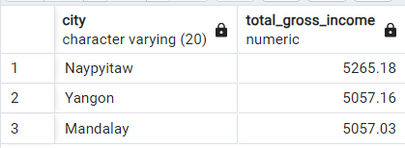
4. Calculate the total gross income generated in each city.
INPUT
OUTPUT

Slide 11
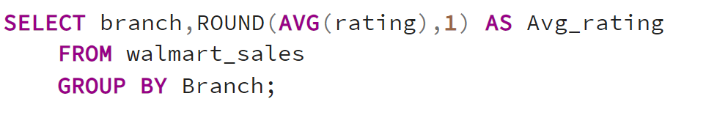
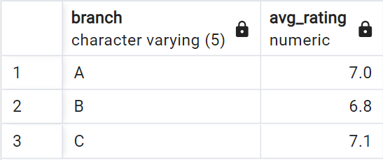
5. Find the average rating given bbbbbBy customers in each Bbbbbranch.
INPUT
OUTPUT

Slide 12
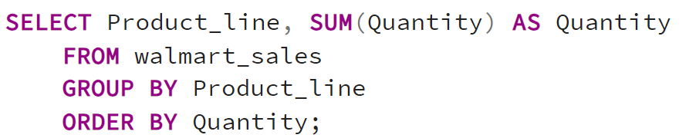
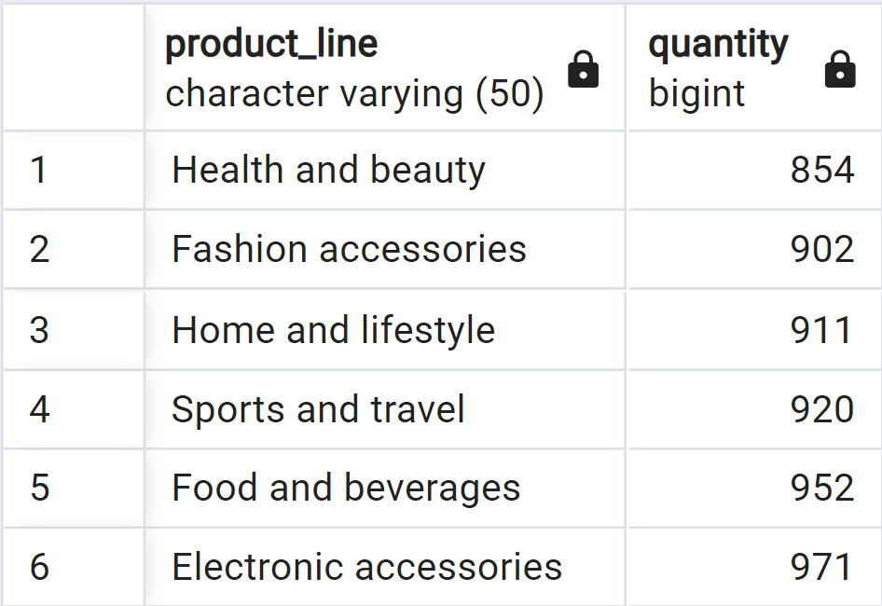
6. Determine the total quantity of each product line sold.
INPUT
OUTPUT

Slide 13
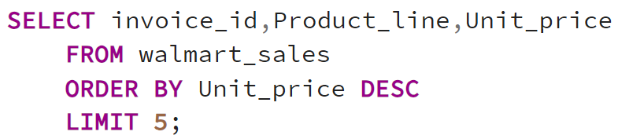
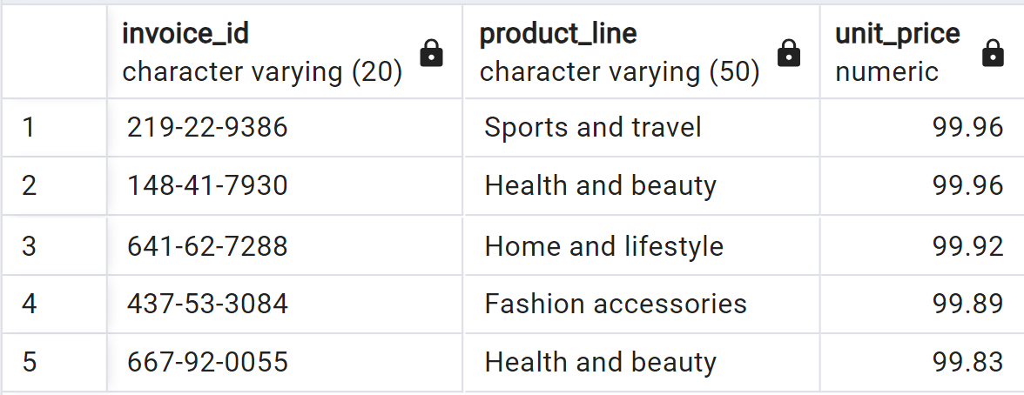
7. List the top 5 products bBby unit price.
INPUT
OUTPUT

Slide 14
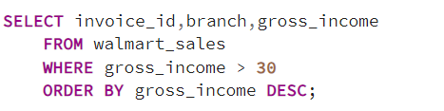
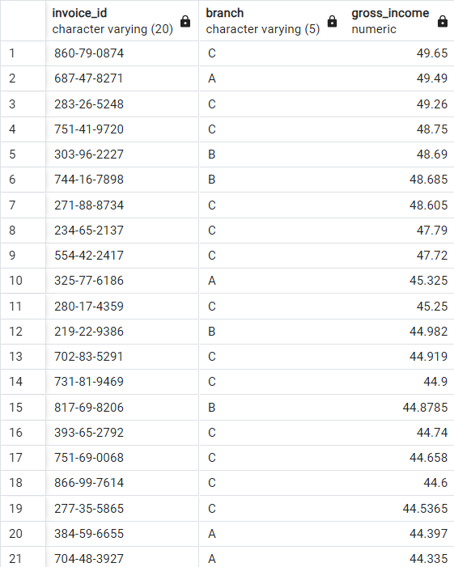
8. Find sales transactions with a gross_income greater than 30.
INPUT
OUTPUT

Slide 15
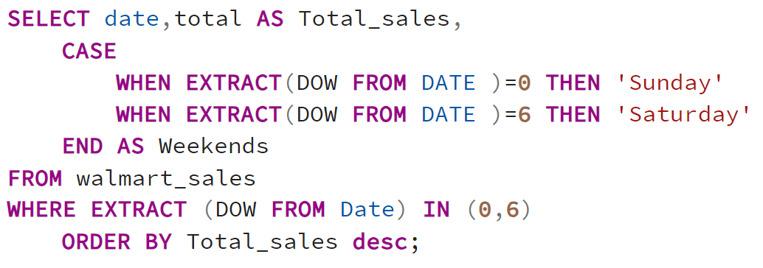
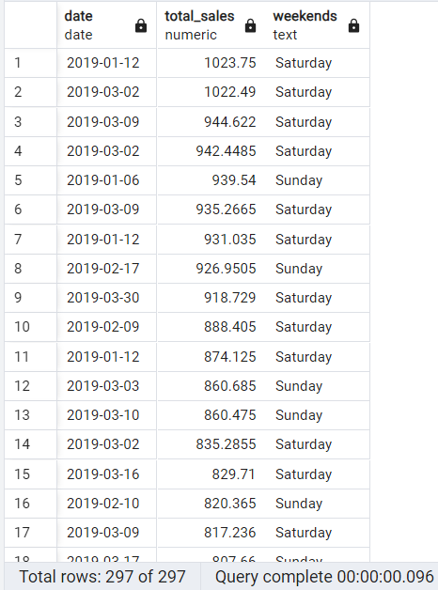
9. Retrieve sales transactions that occurred on weekends.
INPUT
OUTPUT

Slide 16
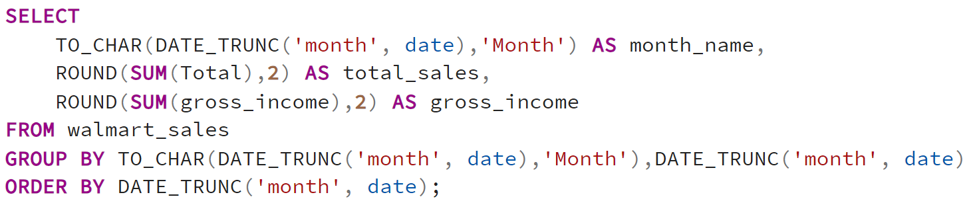
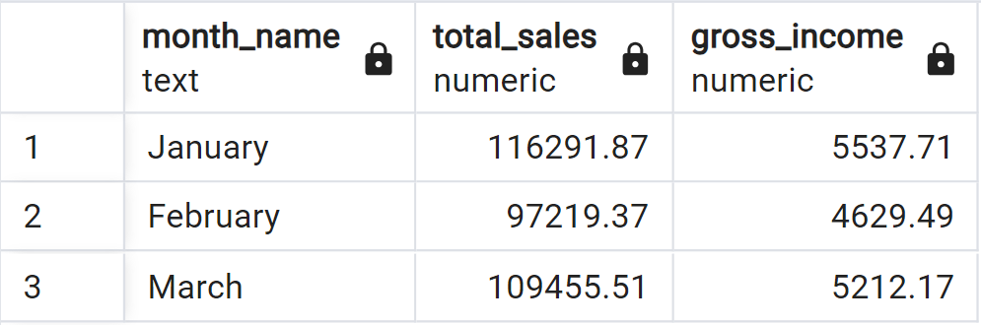
10.Calculate the total sales and gross income for each month.
INPUT
OUTPUT

Slide 17
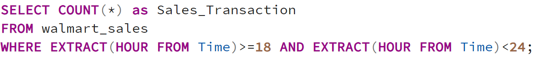
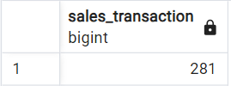
11. Find the number of sales transactions that occurred after 6 PM.
INPUT
OUTPUT

Slide 18
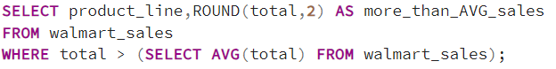
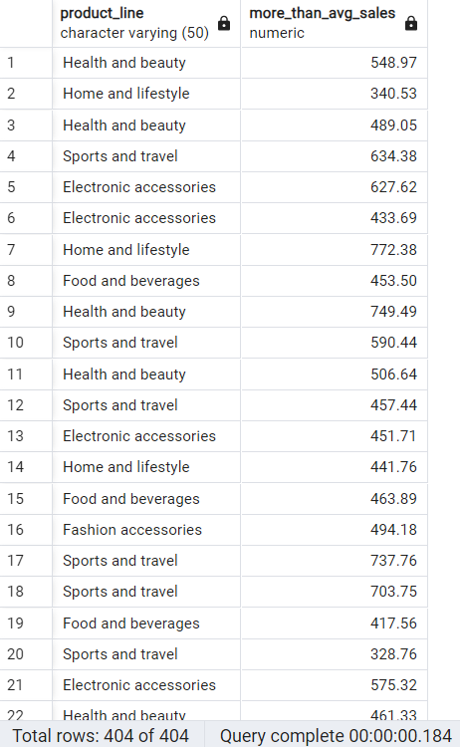
12. List the sales transactions that have a higher total than the average total of all transactions.
INPUT
OUTPUT

Slide 19
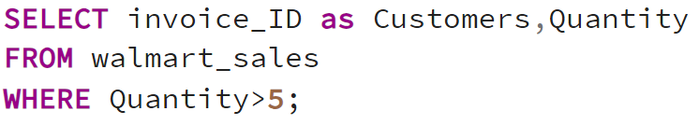
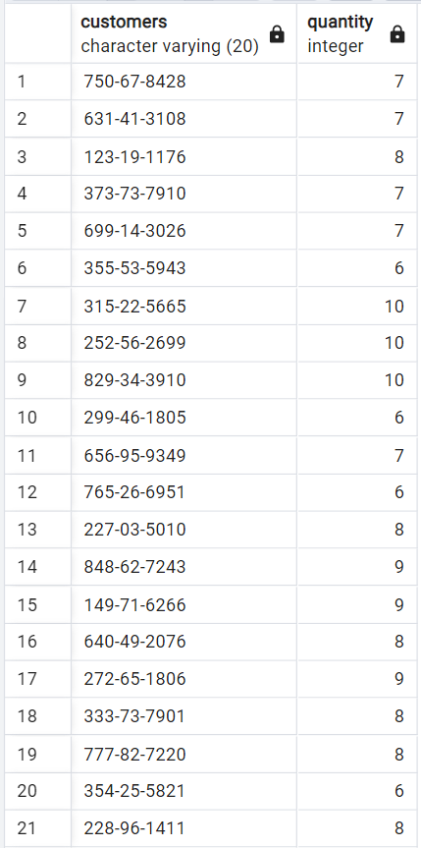
13. Find customers who made more than 5 purchases in a single month.
INPUT
OUTPUT

Slide 20
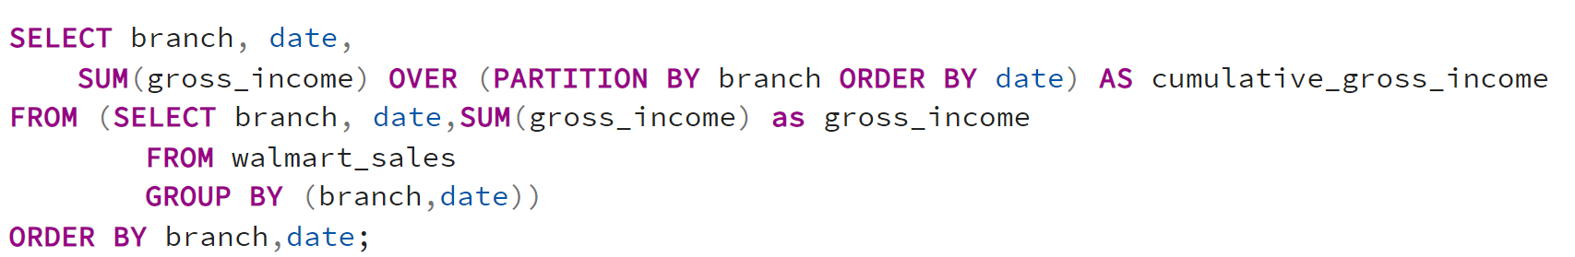
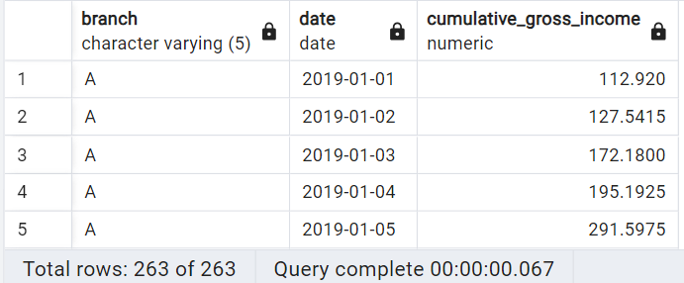
14. Calculate the cumulative gross income for each bbBranch bBy date.
INPUT
OUTPUT

Slide 21
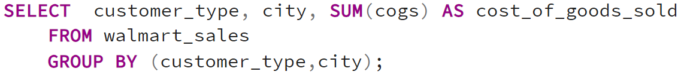
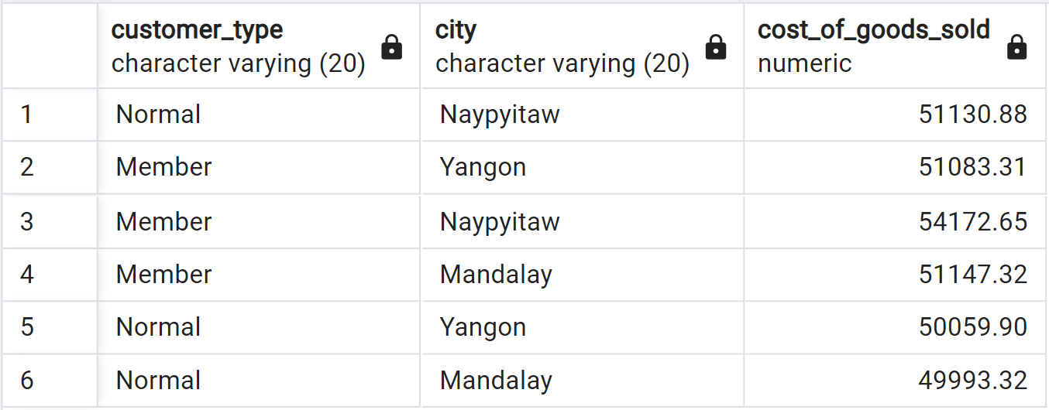
15. Find the total COGS for each customer_type in each city.
INPUT
OUTPUT

Slide 22
INSIGHTS
1. Naypyitaw City has Highest Total Gross income.
2. Food and Beverages generated Highest Revenue of 56144.
2. 281 Transactions occured after 6:00 PM.
3. Highest sales made in month of JANUARY which is 116291.
4. Products comes under Sports and Travel has Highest unit price which is 99.96.

Slide 23
Thank you!

